Slide 1





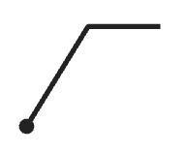










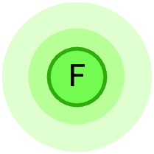




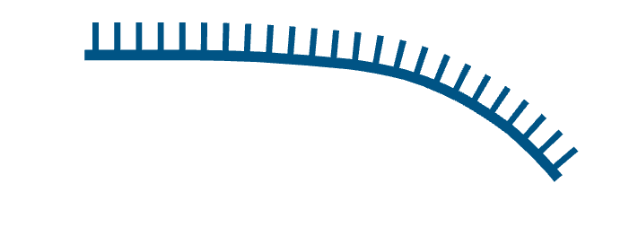




















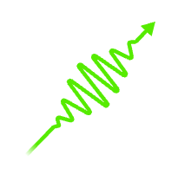
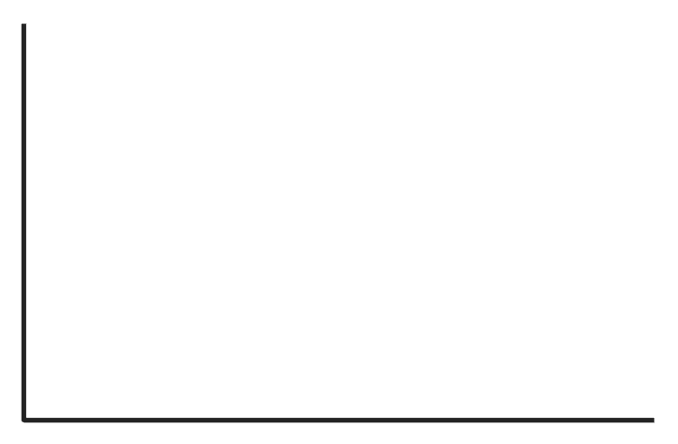
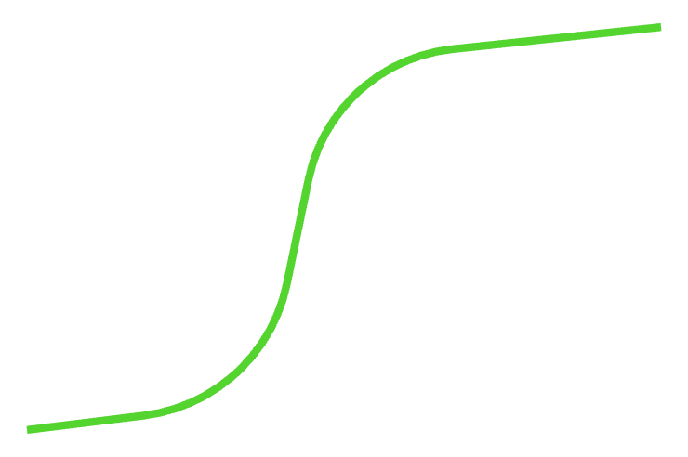









Fluorescent Probe-Based Real Time PCR (qPCR)
Initiation
Denaturation (95°C)
Primer annealing (60°C)
Extension (72°C)
Polymerization
Polymerase
5'
5'
Reverse primer
3'
Template DNA
Fluorescent
reporter released
5'
5'
Denaturation
3'
3'
Forward primer
Bound probe
5'
3'
3'
Key concept
Results
Fluorescent signal
Fluorescent reporter
Amplification
Quencher
Fluorescence
Threshold
Polymerase
cleavage
No amplification
Ground state fluorophore
Excited state fluorophore
Cycles

Slide 2


Get the BioRender Add-in for PowerPoint
Our integration allows you to unlock the power of BioRender, right inside PowerPoint:
  Export your BioRender presentation as an editable .PPTX file.
  Edit BioRender figures without leaving your PowerPoint slides.
  Sync updates from BioRender with just one click.
  Effortlessly manage sharing and permissions with your team.
  Access your entire BioRender library at your fingertips.
  Need a transparent background? Toggle it on or off, anytime.
BioRender for PowerPoint is hosted safely and securely in the Microsoft AppSource.
This presentation was created in BioRender
To access the original source of this presentation, visit:
https://app.biorender.com/illustrations/6922f52239572f2dc8949e40
Sign up for your own BioRender account at www.biorender.com
Get the add-in now:
https://appsource.microsoft.com/en-us/product/office/wa200006038?src=product&mktcmpid=pptx_export

